Slide 1

UNIVERSITY OF MASSACHUSETTS
Dept. of Electrical & Computer Engineering
Digital Computer Arithmetic
ECE 666
Part 5a
Fast Addition
Israel Koren
Spring 2008

Slide 2
Ripple-Carry Adders
Addition - most frequent operation - used also for multiplication and division - fast two-operand adder essential
Simple parallel adder for adding xn-1,xn-2,...,x0 and yn-1,yn-2,…,y0 - using n full adders
Full adder - combinational digital circuit with input bits xi,yi and incoming carry bit ci and output sum bit si and outgoing carry bit ci+1 - incoming carry for next FA with input bits xi+1,yi+1
si = xi ⊕ yi ⊕ ci
ci+1 = xi ⋅ yi + ci ⋅ (xi + yi)
⊕ - exclusive-or ; ⋅ - AND ; + - OR

Slide 3
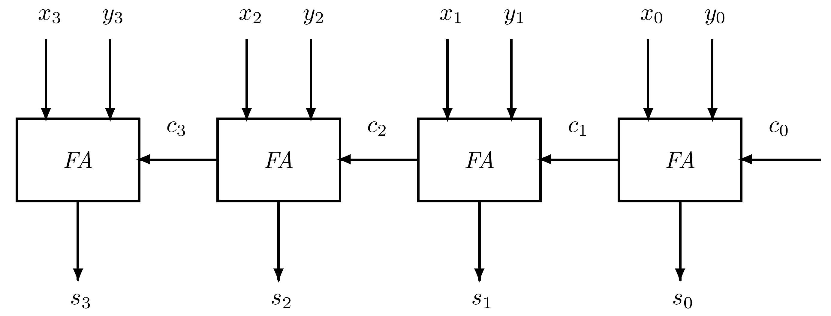
Parralel Adder with 4 FAs
Ripple-Carry Adder
In a parallel arithmetic unit
  All 2n input bits available at the same time
  Carries propagate from the FA in position 0 (with inputs x0 and y0) to position i before that position produces correct sum and carry-out bits
  Carries ripple through all n FAs before we can claim that the sum outputs are correct and may be used in further calculations

Slide 4
Ripple-Carry Adder
FA in position i - combinatorial circuit - sees incoming ci=0 at start of operation - accordingly produces si
ci may change later on - resulting in change in si
Ripple effect observed at sum outputs of adder until carry propagation is complete
In add operation c0=0 - FA can be simpler - adding only two bits - half adder (HA) - Boolean equations obtained by setting ci=0
FA used for adding 1 in least-significant position (ulp) - to implement subtract operation in two's complement
One's complement of subtrahend taken and a forced carry added to FA in position 0 by setting c0=1

Slide 5
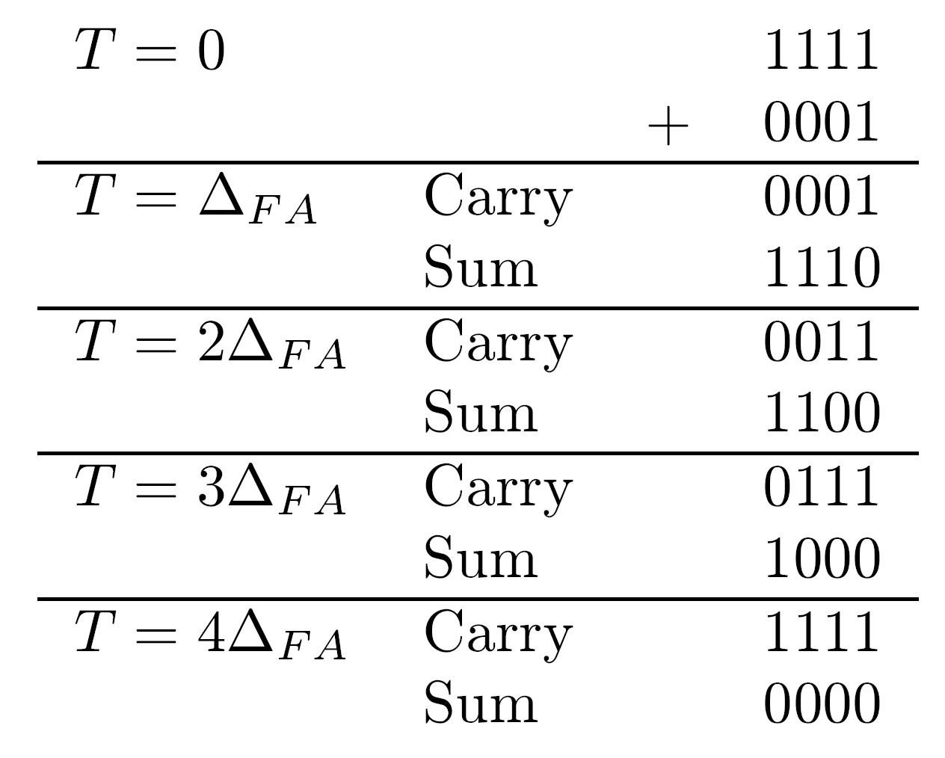
Example
  x0=1111 ; y3,y2,y1,y0=0001
  ΔFA - operation time - delay
  Assuming equal delays for sum and carry-out
  Longest carry propagation chain when adding two 4-bit numbers
In synchronous arithmetic units - time allowed for adder's operation is worst-case delay - nΔFA
Adder assumed to produce correct sum after this fixed delay even for very short carry propagation time as in 0101+0010
Subtract 0101-0010
  adding two's complement of subtrahend to minuend
  one's complement of 0010 is 1101
  forced carry c0=1 ∗ result 0011

Slide 6
Reducing Carry Propagation Time
(1) Shorten carry propagation delay
(2) Detect completion of carry propagation - no waiting for fixed delay nΔFA
Second approach - variable addition time - inconvenient in a synchronous design
Concentrate on first approach - several schemes for accelerating carry propagation exist
Exercise - Find a technique for detection of carry completion

Slide 7
Carry-Look-Ahead Adders
Objective - generate all incoming carries in parallel
Feasible - carries depend only on xn-1,xn-2,...,x0 and yn-1,yn-2,…,y0 - information available to all stages for calculating incoming carry and sum bit
Requires large number of inputs to each stage of adder - impractical
Number of inputs at each stage can be reduced - find out from inputs whether new carries will be generated and whether they will be propagated

Slide 8
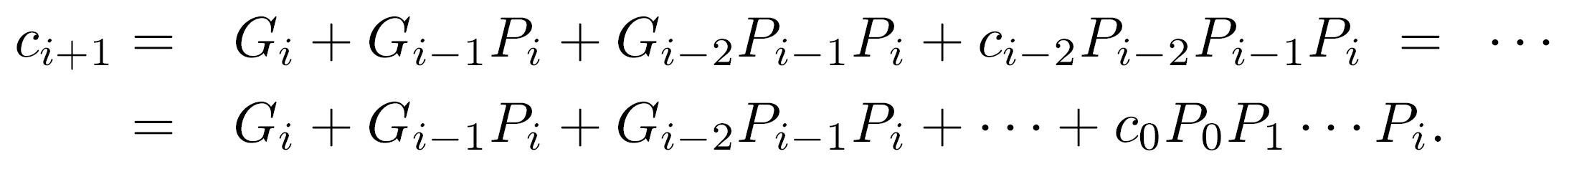
Carry Propagation
If xi=yi=1 - carry-out generated regardless of incoming carry - no additional information needed
If xi,yi=10 or xi,yi=01 - incoming carry propagated
If xi=yi=0 - no carry propagation
Gi=xi yi - generated carry ; Pi=xi+yi - propagated carry
ci+1= xi yi + ci (xi + yi) = Gi + ci Pi
Substituting ci=Gi-1+ci-1Pi-1 → ci+1=Gi+Gi-1Pi+ci-1Pi-1Pi
Further substitutions -
All carries can be calculated in parallel from xn-1,xn-2,...,x0 , yn-1,yn-2,…,y0 , and forced carry c0

Slide 9
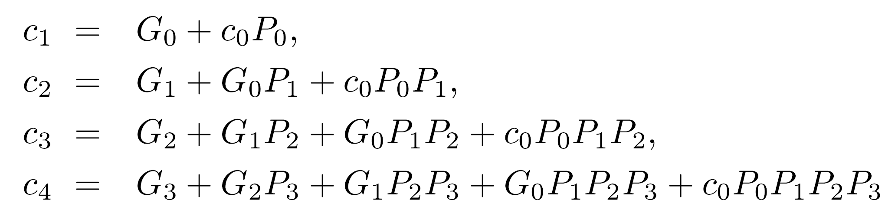
Example - 4-bit Adder

Slide 10
Delay of Carry-Look-Ahead Adders
ΔG - delay of a single gate
At each stage
  Delay of ΔG for generating all Pi and Gi
  Delay of 2ΔG for generating all ci (two-level gate implementation)
  Delay of 2ΔG for generating sum digits si in parallel (two-level gate implementation)
  Total delay of 5ΔG regardless of n - number of bits in each operand
Large n (=32) - large number of gates with large fan-in
  Fan-in - number of gate inputs, n+1 here
Span of look-ahead must be reduced at expense of speed

Slide 11
Reducing Span
n stages divided into groups - separate carry-look-ahead in each group
Groups interconnected by ripple-carry method
  Equal-sized groups - modularity - one circuit designed
  Commonly - group size 4 selected - n/4 groups
  4 is factor of most word sizes
  Technology-dependent constraints (number of input/output pins)
  ICs adding two 4 digits sequences with carry-look-ahead exist
    ΔG needed to generate all Pi and Gi
    2ΔG needed to propagate a carry through a group once the Pi,Gi,c0 are available
    (n/4)2ΔG needed to propagate carry through all groups
    2ΔG needed to generate sum outputs
  Total - (2(n/4)+3)ΔG = ((n/2)+3)ΔG - a reduction of almost 75% compared to 2nΔG in a ripple-carry adder

Slide 12
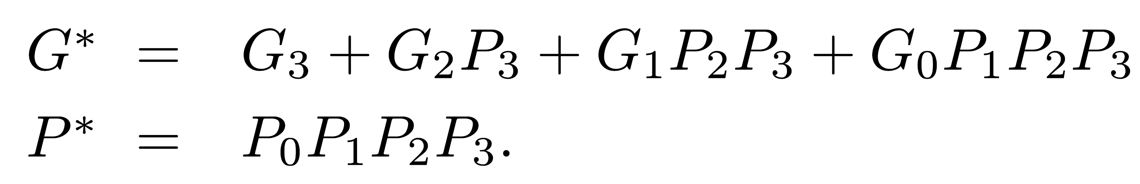
Further Addition Speed-Up
Carry-look-ahead over groups
Group-generated carry - G*=1 if a carry-out (of group) is generated internally
Group-propagated carry - P*=1 if a carry-in (to group) is propagated internally to produce a carry-out (of group)
For a group of size 4:
Group-carries for several groups used to generate group carry-ins similarly to single-bit carry-ins
A combinatorial circuit implementing these equations available - carry-look-ahead generator

Slide 13
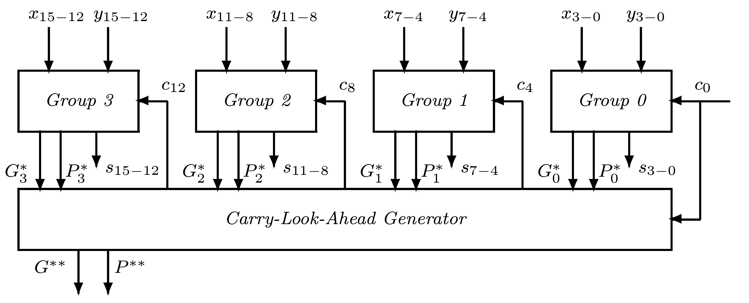
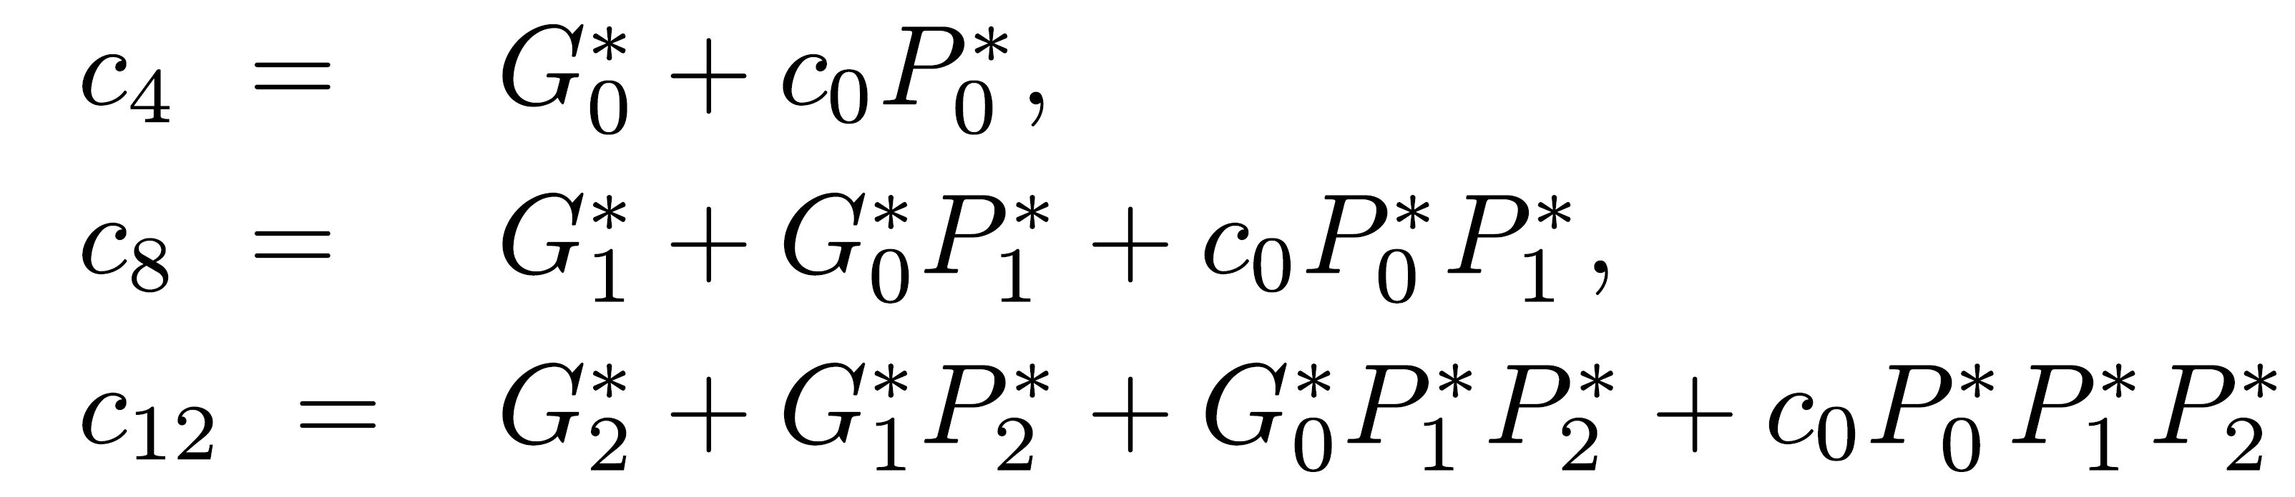
Example - 16-bit 2-level Carry-look-ahead Adder
n=16 - 4 groups
Outputs G*0,G*1,G*2,G*3,P*0,P*1,P*2,P*3
Inputs to a carry-look-ahead generator with outputs c4,c8,c12

Slide 14
Example - Cont.
Operation - 4 steps:
  1. All groups generate in parallel Gi and Pi - delay ΔG
  2. All groups generate in parallel group-carry-generate - G*i and group-carry-propagate - P*i - delay 2ΔG
  3. Carry-look-ahead generator produces carries c4,c8,c12 into the groups - delay 2ΔG
  4. Groups calculate in parallel individual sum bits with internal carry-look-ahead - delay 4ΔG
Total time - 9ΔG
If external carry-look-ahead generator not used and carry ripples among the groups - 11ΔG
Theoretical estimates only - delay may be different in practice

Slide 15
Additional Levels of Carry-look-ahead
Carry-look-ahead generator produces G** and P**, - section-carry generate and propagate
  section is a set of 4 groups and consists of 16 bits
For 64 bits, either use 4 circuits with a ripple-carry between adjacent sections, or use another level of carry-look-ahead for faster execution
This circuit accepts 4 pairs of section-carry-generate and section-carry-propagate, and produces carries c16, c32, and c48
As n increases, more levels of carry-look-ahead generators can be added
Number of levels (for max speed up) → logbn
  b is the blocking factor - number of bits in a group, number of groups in a section, and so on
Overall addition time is proportional to logbn

Slide 16
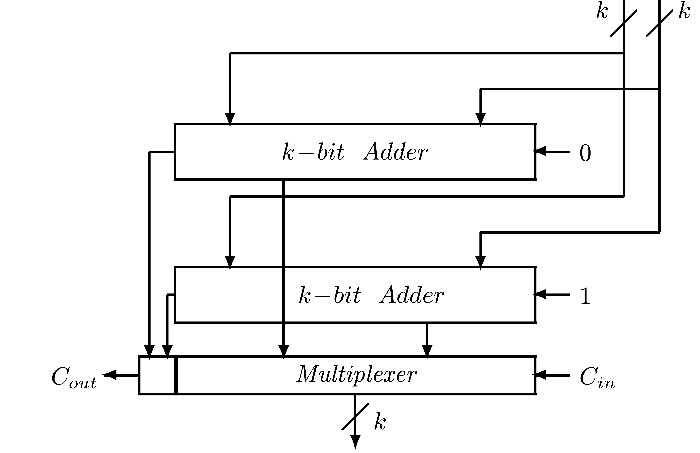
Conditional Sum Adders
Logarithmic speed-up of addition
For given k operand bits - generate two outputs - each with k sum bits and an outgoing carry - one for incoming carry 0 and one for 1
When incoming carry known - select correct output out of two - no waiting for carry to propagate
Not to all n bits at once

Slide 17
Dividing into Groups
Divide n bits into smaller groups - apply above to each
Serial carry-propagation inside groups done in parallel
Groups can be further divided into subgroups
Outputs of subgroups combined to generate output of groups
Natural division of n - two groups of n/2 bits each
Each can be divided into two groups of n/4, and so on
If n power of 2 - last subgroup is of size 1 and log n steps are needed
Division not necessarily into equal-sized subgroups - scheme can be applied even if n not a power of 2
2

Slide 18
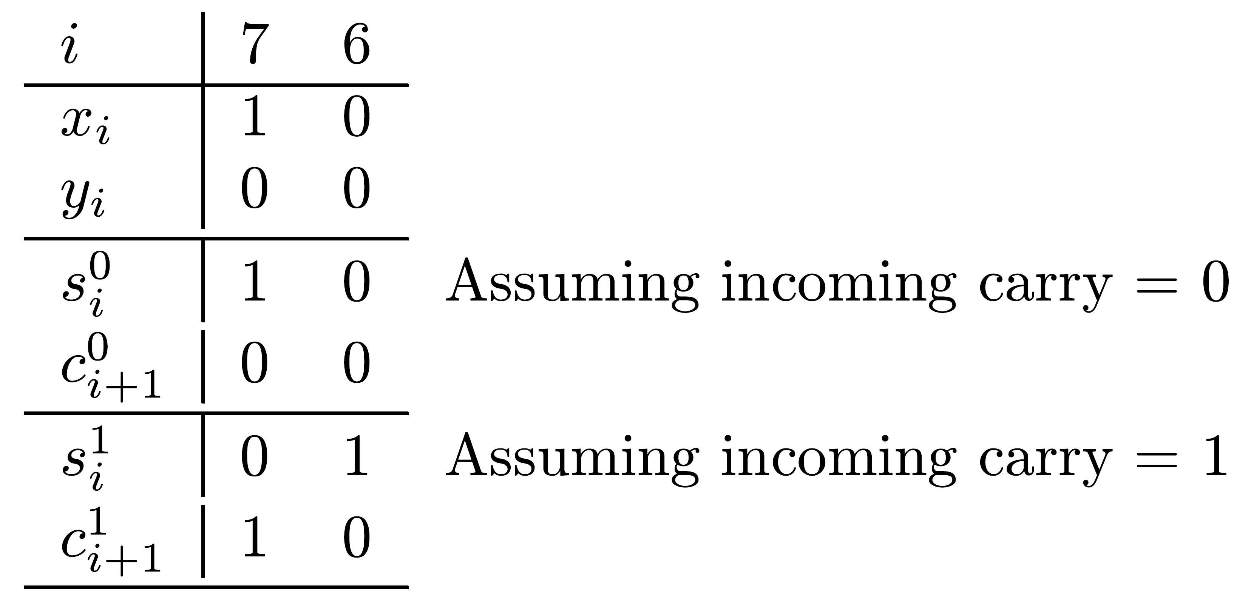
Example - Combining Single Bits into Pairs
0
1
si / si - sum bit at position i under the assumption that incoming carry into currently considered group is 0 /1
Similarly - outgoing carries (from group) ci+1 / ci+1
Step 1 - each bit constitutes a separate group:
0
1

Slide 19
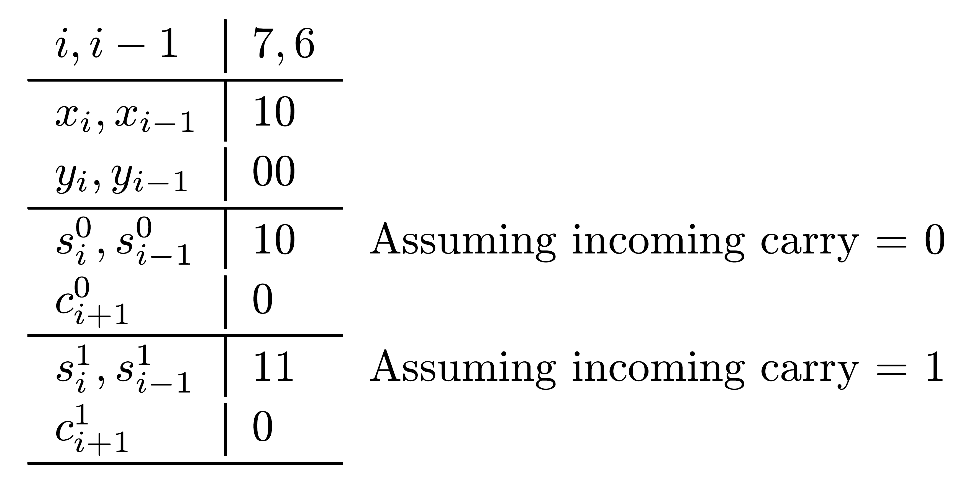
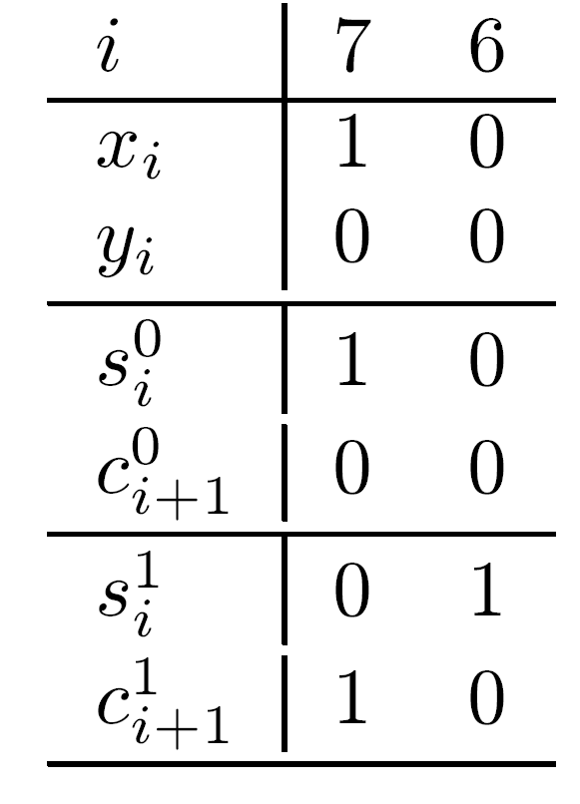
Example - Step 2
Step 2 - two bit positions combined (using data selectors) into one group of size 2
Carry-out from position 6 becomes internal (to group) carry and appropriate set of outputs for position 7 selected

Slide 20
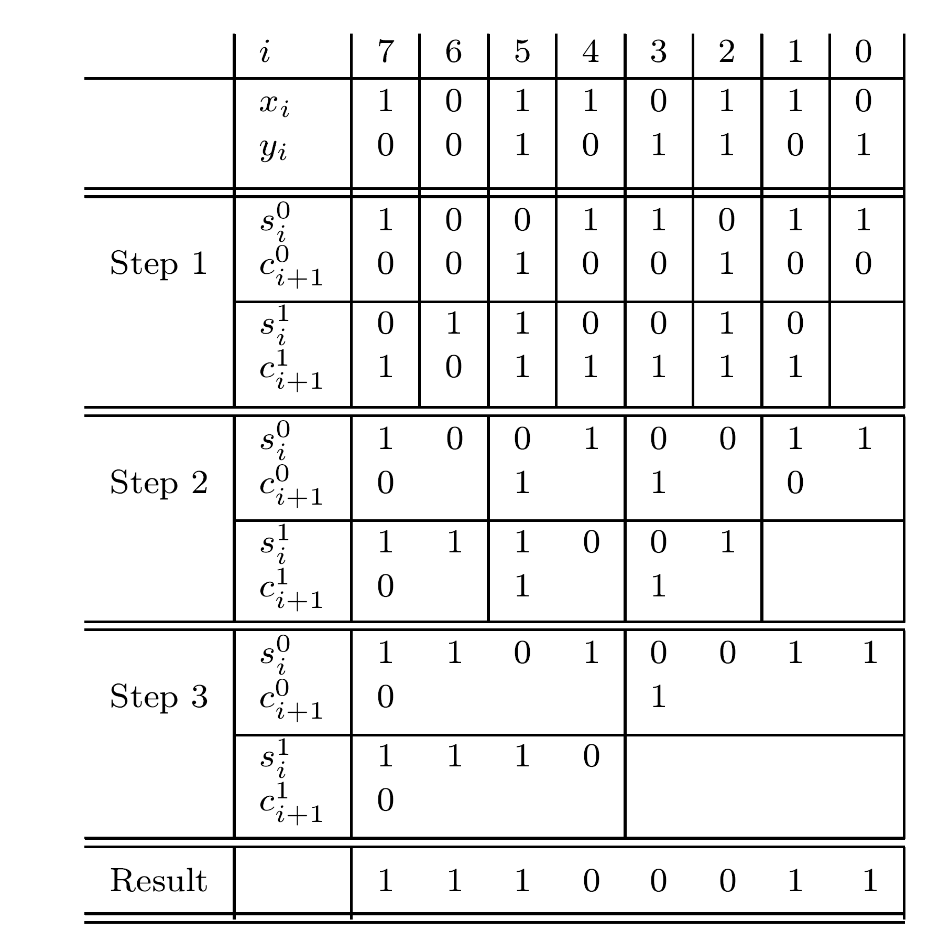
Example - Addition of Two 8-bit
Operands
Log 8=3 steps
Forced carry (=0 here) available at start
Only one set of outputs generated for rightmost group at each step
2

Slide 21
Carry-Select Adder
Variation of conditional sum adder
n bits divided into groups - not necessarily equal
Each group generates two sets of sum bits and an outgoing carry bit - incoming carry selects one
Each group is not further divided into subgroups
Comparing Conditional-sum and Carry-look-ahead
  Both methods have same speed
  Design of conditional sum adder less modular
  Carry-look-ahead adder more popular

Slide 22
Optimality of Algorithms and Their Implementations
Numerous algorithms for fast addition proposed -technology keeps changing making new algorithms more suitable
Performance of algorithm affected by its unique features and number system used to represent operands and results
Many studies performed to compare performance of different algorithms - preferably independently of implementation technology
Some studies find the limit (bound) on the performance of any algorithm in executing a given arithmetic operation

Slide 23
Optimal Addition Algorithms
Execution time reduced by avoiding (or limiting) carry-propagation
Number systems such as the residue number system and the SD number system have almost carry-free addition - provide fast addition algorithms
These number systems not frequently used - conversions between number systems needed - may be more complex than addition - not always practical

Slide 24
Lower Bound on Addition Speed
Theoretical model - derives a bound independent of implementation technology
Assumptions:
  Circuit for addition realized using only one type of gate - (f,r) gate - r is radix of number system used and f is fan-in of gate (maximum number of inputs)
  All (f,r) gates are capable of computing any r-valued function of f (or less) arguments in exactly the same time
  This fixed time period is the unit delay - computation time of adder circuit measured in these units
(f,r) gate can compute any function of f arguments - all we need to find out is how many such gates are required and how many circuit levels are needed in order to properly connect the gates

Slide 25
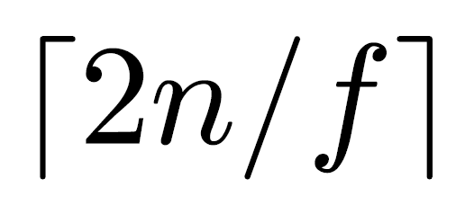
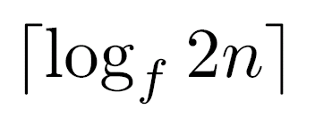
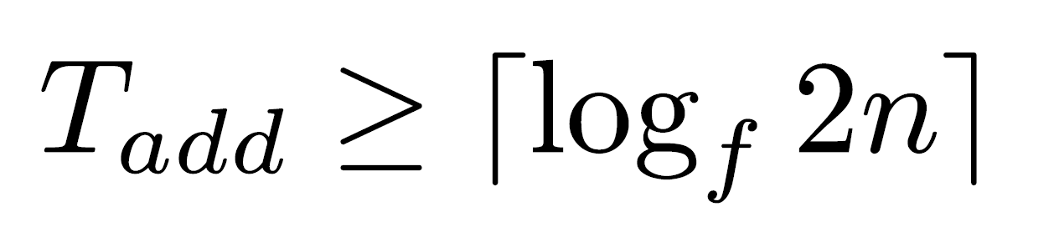
Lower Bound - Cont.
A circuit for adding two radix-r operands with n digits each - 2n inputs and n+1 outputs
Consider output requiring all 2n inputs - can be reduced to a smaller number of arguments by using such (f,r) gates operating in parallel
Number of intermediate arguments - - can be further reduced by a second level of (f,r) gates
Number of levels in tree - at least
Lower bound - assumes that no argument is needed as input to more than one (f,r) gate
Lower bound on addition time - measured in units of (f,r) gate delay -

Slide 26
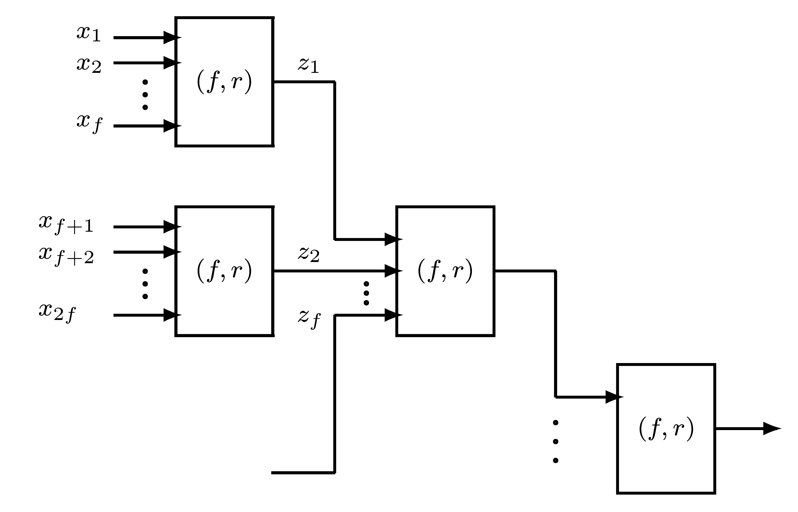
Circuit Implemented with (f,r) Gates

Slide 27
Limitations of Model
Only fan-in limitation considered - fan-out ignored
Fan-out of gate - ability of its output to drive a number of inputs to similar gates in the next level
In practice fan-out is constrained
More important - model assumes that any r-valued function of f arguments can be calculated by a single (f,r) gate in one unit delay - not true in practice
Many functions require either a more complex gate (longer delay) or are implemented using several simple gates organized in two or more levels

Slide 28
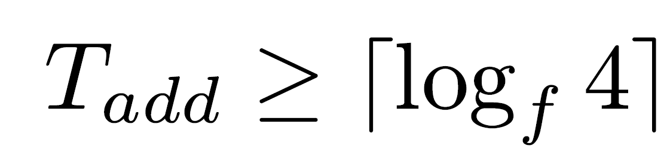
Improved Bound
Previous bound assumes at least one output digit that depends on all 2n input digits
If not - a better (lower) value for the bound exists - smaller trees (with fewer inputs) can be used
This occurs if carry cannot propagate from least-significant to most-significant position
Example - only xi,yi,xi-1,yi-1 needed to determine sum digit si -
In the binary system - carry can propagate through all n positions -
In the two addition algorithms - carry-look-ahead and conditional sum - execution time proportional to log n - previous bound approached

Slide 29
Implementation Cost
Implementation cost must be considered in addition to execution time
Implementation cost measure depends on technology
Example - discrete gates
  Number of gates measures implementation cost
  Number of gates along the critical (longest) path (number of circuit levels) determines execution time
Example - full custom VLSI technology
  Number of gates - limited effect on implementation cost
  Regularity of design and length of interconnections more important - affect both silicon area and design time
Trade-off between implementation cost and addition speed exists

Slide 30
Performance - Cost Trade-off
If performance more important - carry-look-ahead adder preferable
Implementation cost can be reduced - determined by regularity of design and size of required area
Taking advantage of the available degree of freedom in design - the blocking factor - bounded by fan-in constraint
Additional constraints exist - e.g., number of pins
Highest blocking factor - not necessarily best
Example - blocking factor of 2 results in a very regular layout of binary trees with up to log2n levels - total area approximately n⋅log2n

Slide 31
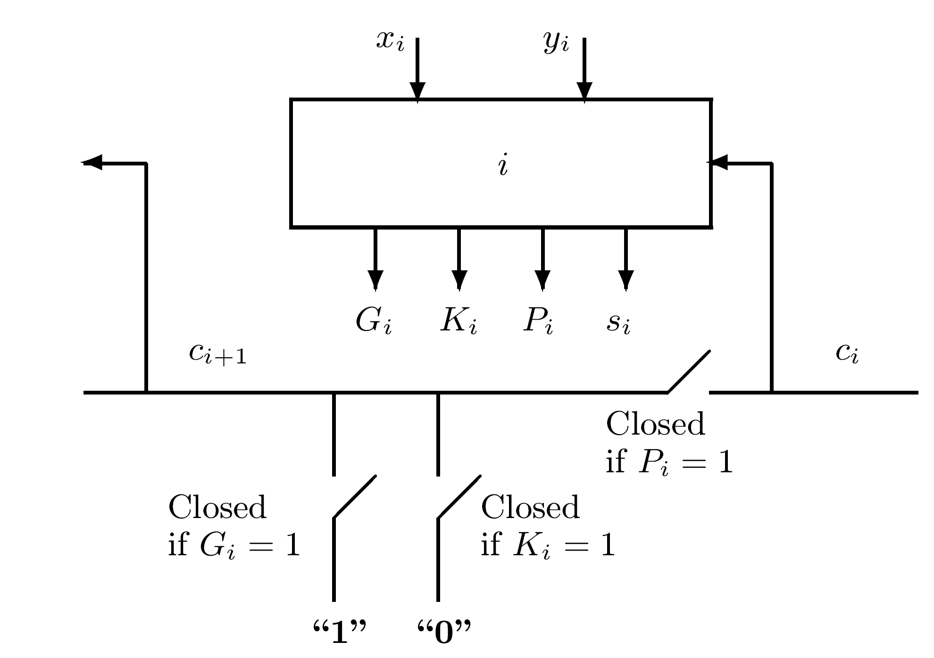
Manchester Adder
If lower implementation cost required - ripple- carry method with speed -up techniques is best
Manchester adder uses switches that can be realized using pass transistors
  Pi=xi ⊕ yi carry-propagate signal
  Gi=xi yi carry-generate signal
  Ki=xiyi carry-kill signal
Only one of the switches is closed at any time
Pi=xi ⊕ yi used instead of Pi=xi + yi
If Gi=1 - an outgoing carry is generated always
If Ki=1 - incoming carry not propagated
If Pi=1 - incoming carry propagated
-
-

Slide 32
Manchester Adder - Cont.
Switches in units 0 through n-1 set simultaneously - propagating carry experiences only a single switch delay per stage
Number of carry-propagate switches that can be cascaded is limited - depends on technology
n units partitioned into groups with separating devices (buffers) between them
In theory - execution time linearly proportional to n
In practice - ratio between execution time and that of another adder (e.g., carry-look-ahead) depends on particular technology
Implementation cost - measured in area and/or design regularity - lower than carry-look-ahead adder

